Slide 1
July 2023 release of Power BI apps on telemetry
Dynamics 365 Business Central

Slide 2
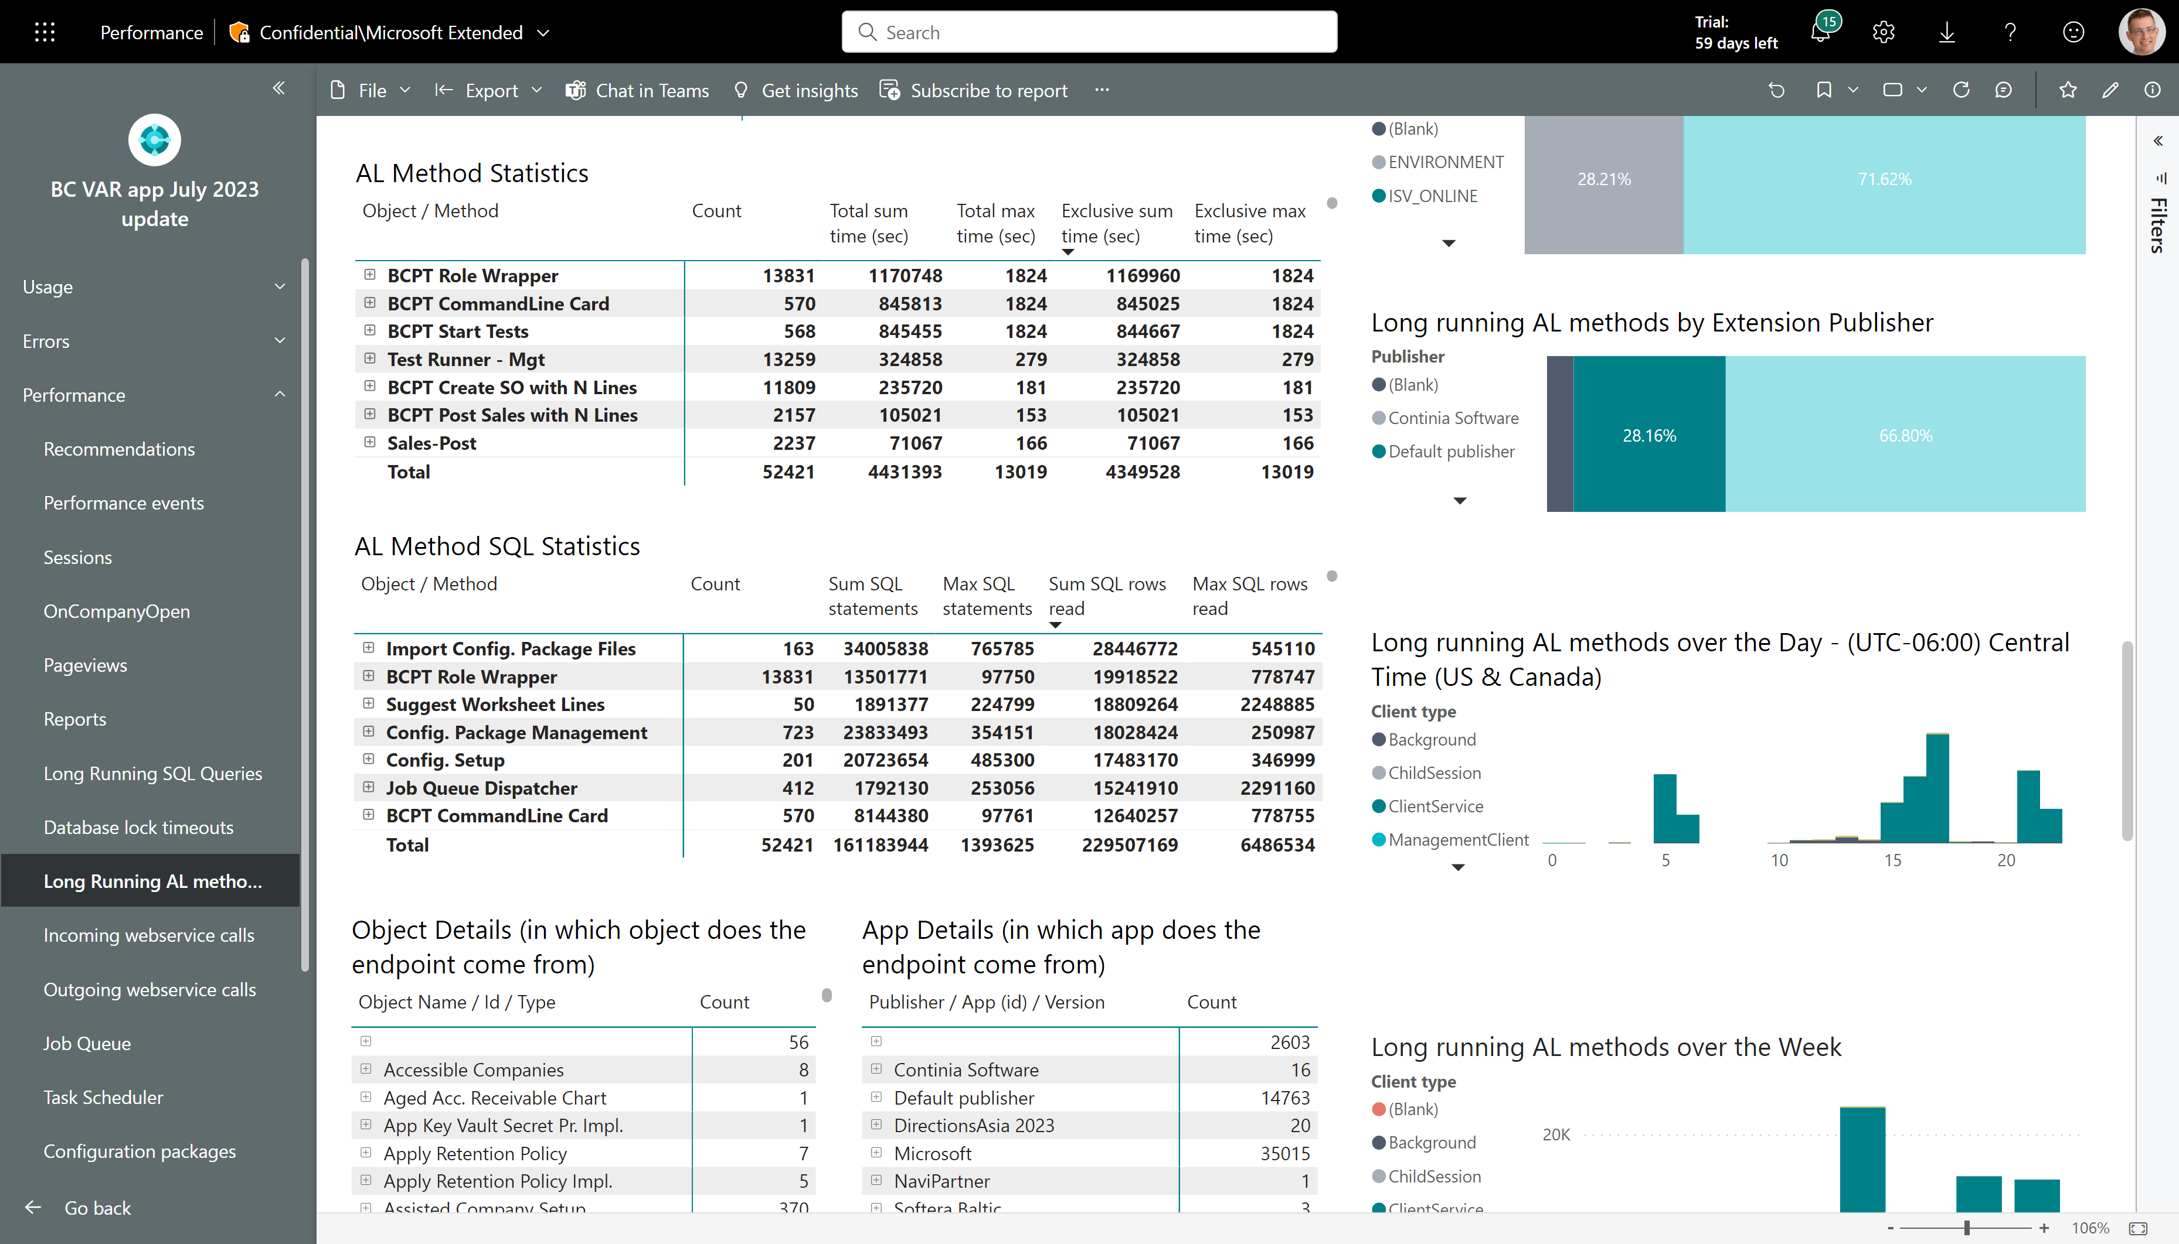
Long running AL methods – see SQL statistics
Now also shows SQL statistics for long running AL methods
SQL statistics can help you determine if a long running AL method is not only spending a lot of time running AL, but as well is also doing work on the database.
Note that the time captured in this event does not include time spend in SQL.

Slide 3
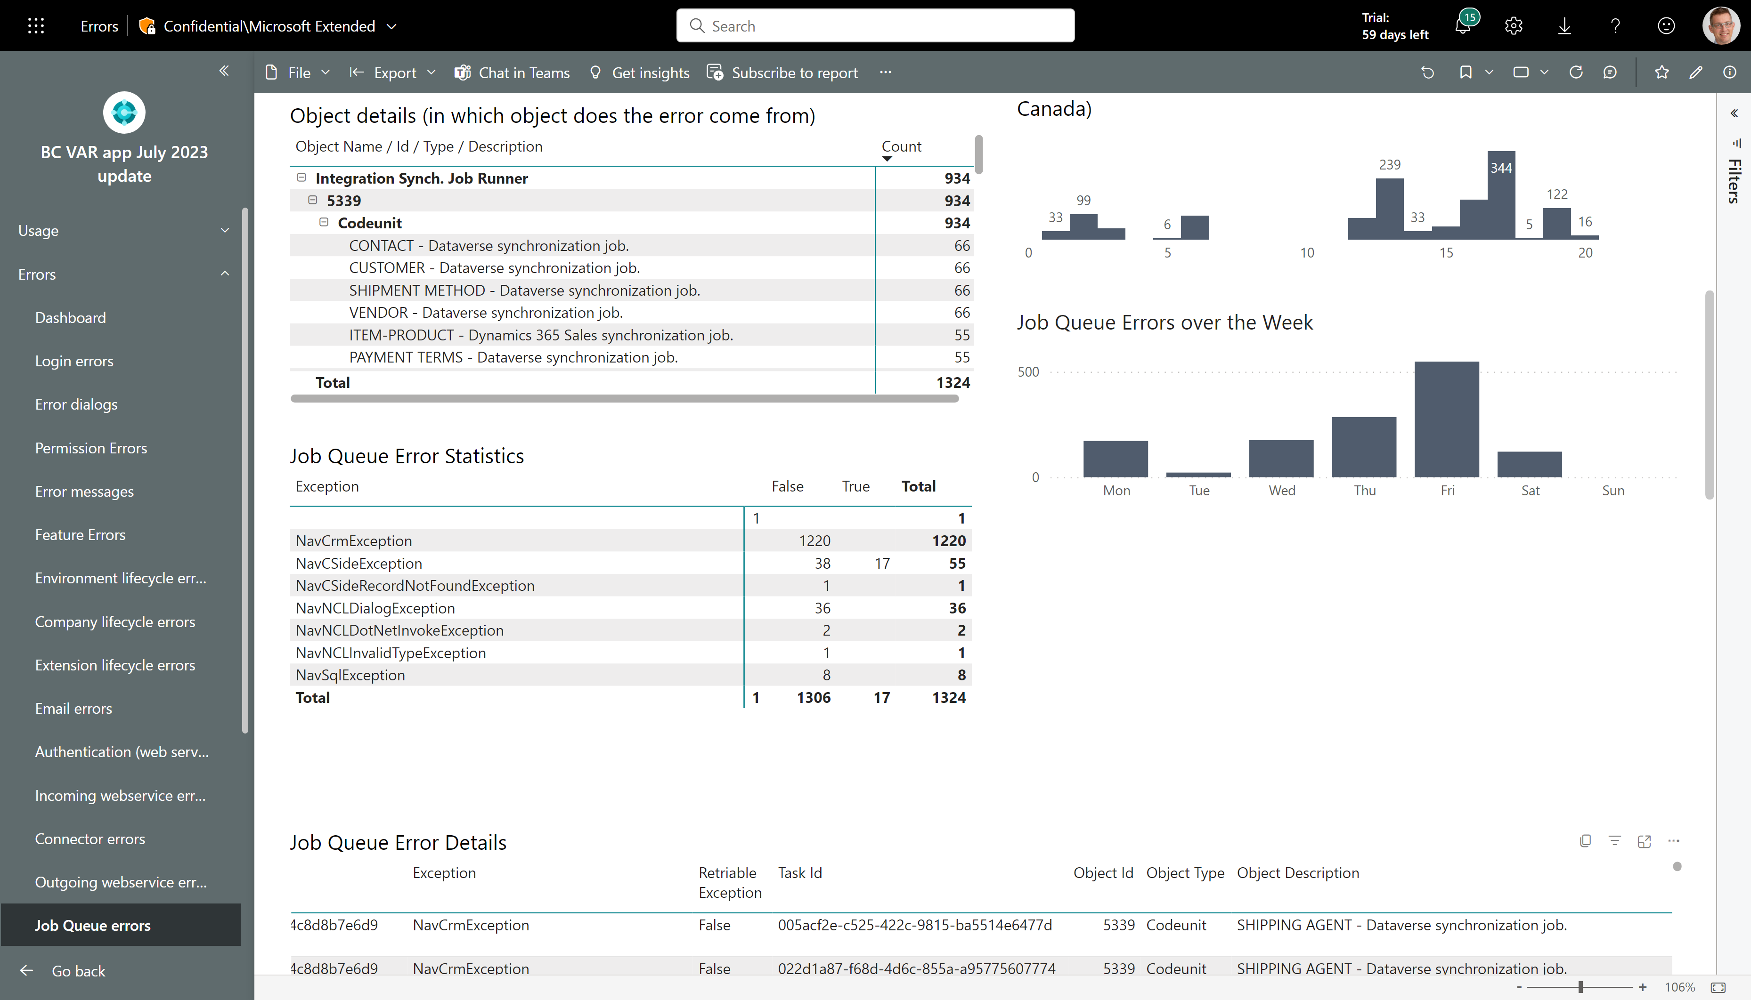
Job Queue Errors – see Job Queue description
Job Queue Descriptions are now emitted to telemetry

Slide 4
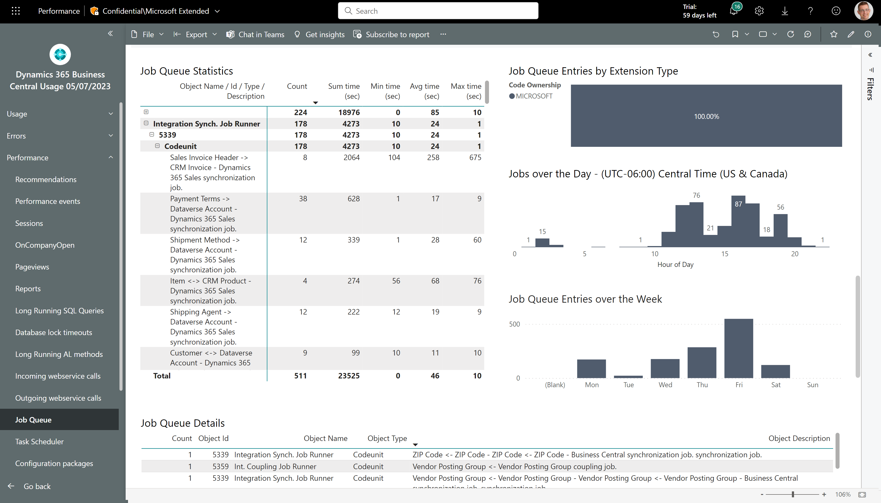
Job Queue Performance – see Job Queue description
Job Queue Descriptions are now emitted to telemetry

Slide 5
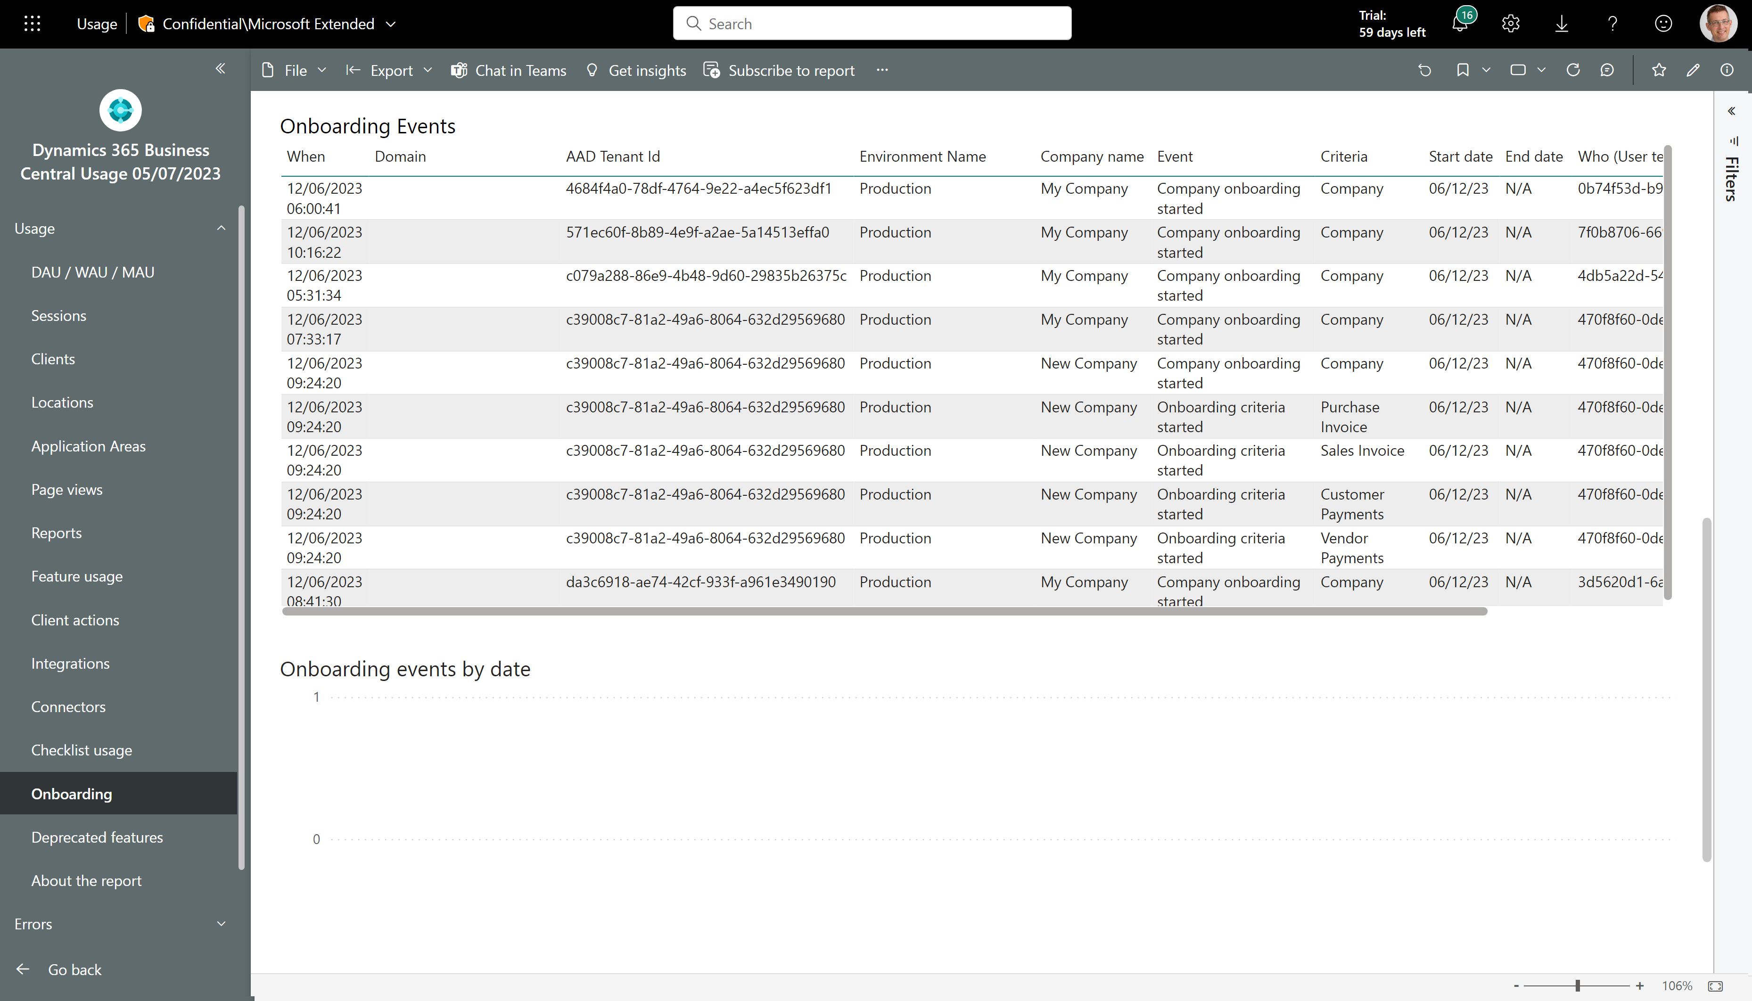
New page: Onboarding
See how environments start and finish onboarding criteria

Slide 6
Get the apps from Appsource
For environment telemetry https://aka.ms/bctelemetryreport
For app telemetry https://aka.ms/bctelemetry-isv-app

